Slide 1

FLIGHT DATA EXPLORATION
Albert Iepure
iepurealbert@gmail.com

Slide 2
Overview
Motivation
Dataset
Data cleansing and analysis
Insights
Conclusion

Slide 3
Motivation
Input: dataset containing information about flights (year 2008)
Challenge: explore the data to identify features that might influence how late or early a flight will be

Slide 4
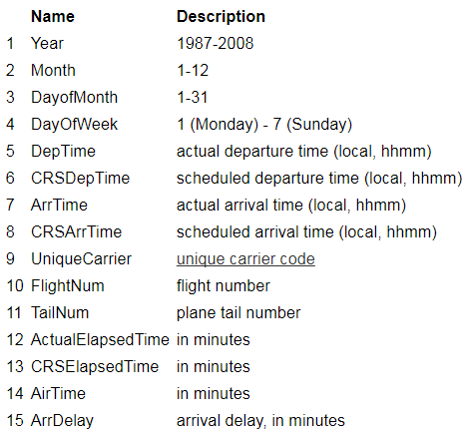
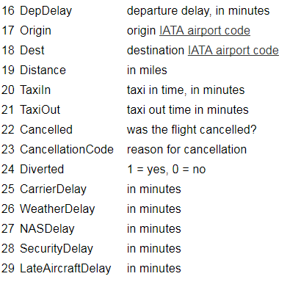
Dataset

Slide 5
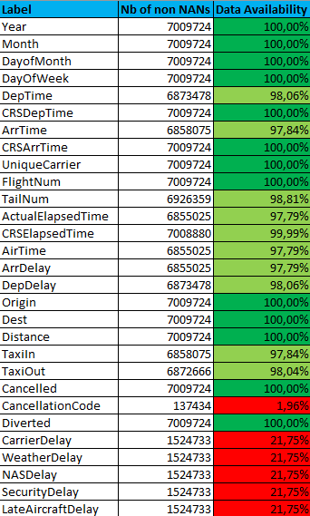
Data cleansing
Initially: 7009728 values
After duplicates removal: 7009724
Poor data availability for some columns
Two scenarios
Scenario 1: Remove data with DA < 21.75%.
After removing the NAN values, we have 6855020 values
Scenario 2 : Keep data with DA >= 21.75%.
After removing the NAN values, we have 1524731 values

Slide 6
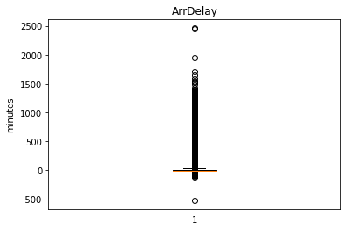
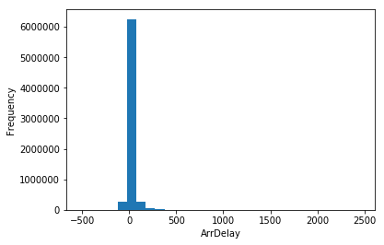
ArrDelay Distribution
Starting point: understand the range and distribution of ArrDelay
Observations
Summary statistics: mean: 8.17 M; σ: 3.85 M; 1Q: -10 M; 2Q: -2 M; 3Q: 12 M
1. median,1Q, 3Q ~ 0 2. wide range 3. right-squed distribution

Slide 7
Compare Numeric Columns (I)
Dataset includes a number of numeric features (e.g. DepDelay - indicates the number of minutes late a flight departed) or psuedo-numeric features (e.g. CRSDepTime - indicates the scheduled departure time as a whole number in 24 hour clock format)
Explore relationship with respect to ArrDelay
Conditional histograms
Condition: below or above 15 min delay

Slide 8
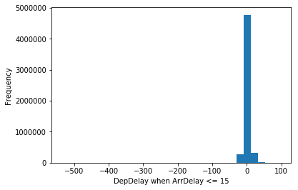
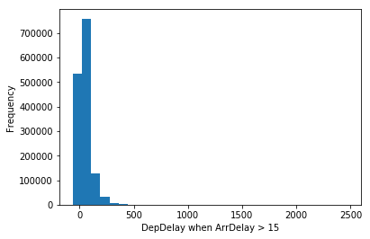
Compare Numeric Columns (II)
Observations
There are significantly more flights that are not later than 15 minutes than there are flights that are more than 15 minutes late.
Flights that are 15 minutes or more late tend to have a higher DepDelay value than flights that are on-time.

Slide 9
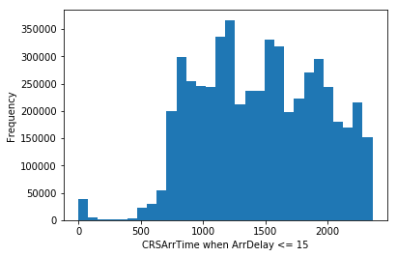
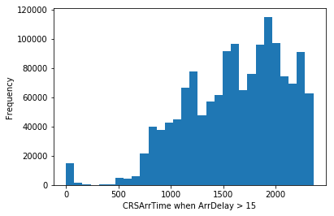
Compare Numeric Columns (III)
Observations
Late flights tend to occur more frequently for flights with a CRSArrTime that is later in the day, the highest volume of delayed flights scheduled to arrive between 15:00 hours and 20:00 hours

Slide 10
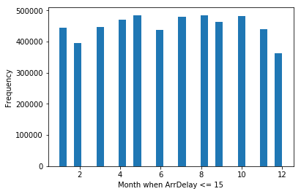
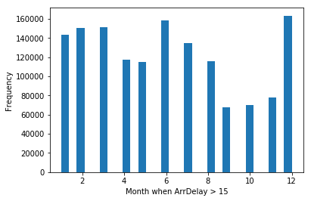
Compare Numeric Columns (IV)
Observations
Considerably fewer delayed flights which are more than 15 minutes late in September – November than throughout the year. Most delays occur in June and December

Slide 11
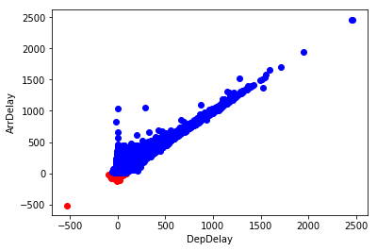
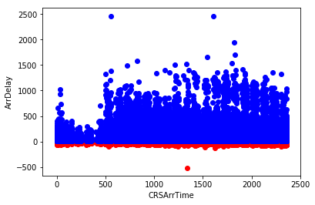
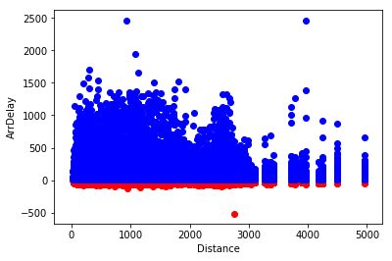
Deeper Insight – Scatter Plots (I)
Observations
There is a near-linear relatonship between DepDelay and ArrDelay for late flights. As departure delay increases, so does arrival delay.
There is an apparent relationship between ArrDelay and CRSDepTime. Flights that depart in the first hours of the day are typically less delayed than flights that are scheduled to depart after around 5am, at which time delays tend to get significantly longer. Delays then gradually get shorter as the day unfolds.
There is an apparent relationship between ArrDelay and Distance

Slide 12
Data cleansing
Initially: 7009728 values
After duplicates removal: 7009724
Poor data availability for some columns
Two scenarios
Scenario 1: Remove data with DA < 21.75%.
After removing the NAN values, we have 6855020 values
Scenario 2 : Keep data with DA >= 21.75%.
After removing the NAN values, we have 1524731 values
Slight mismatches for summary statistics values!

Slide 13
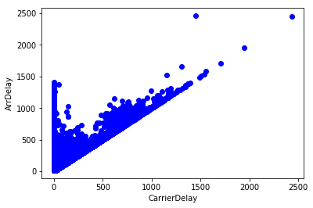
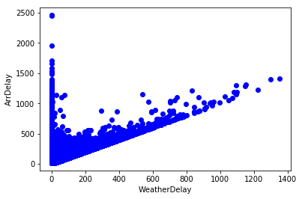
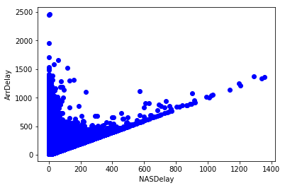
Various Types of Delays
Observations
Since ArrDelay includes each different type of delay, the scatter plots have numerous similarities

Slide 14
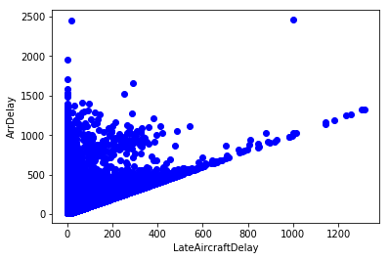
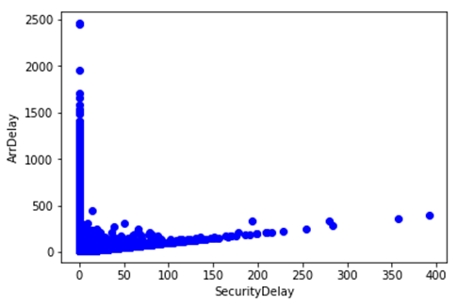
Observations
SecurityDelay appears to have the least impact on ArrDelay

Slide 15
Conclusion
There is a near-linear relatonship between DepDelay and ArrDelay for late flights. As departure delay increases, so does arrival delay.
However, as Distance increases ArrDelay tends to have lower values
CRSDepTime also influences ArrDelay. Flights that depart in the first hours of the day are typically less delayed than flights that are scheduled to depart after around 5am, at which time delays tend to get significantly longer. Delays then gradually get shorter as the day unfolds.

